Slide 1
Power Analysis
PermutationTests.jl

Slide 2
Univariate Tests
Power analysis with several sample sizes (group numerosities) N.
All power estimations are obteined with 1000 simulations.
Permutation tests are exact if the number of possible permutations is <1e5,
approximate otherwise.
Permutation tests are compared to the parametric counterpart.
𝔼(p) is the expected p-value of the tests (effect size) using parametric tests

Slide 3
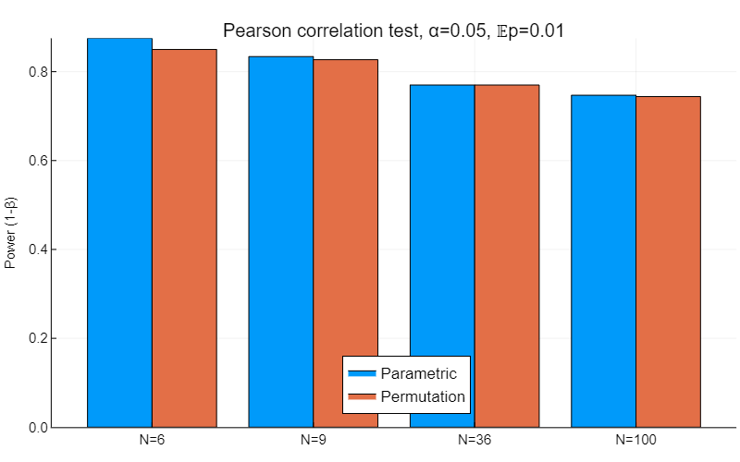
Similar power for permutation and parametric tests

Slide 4
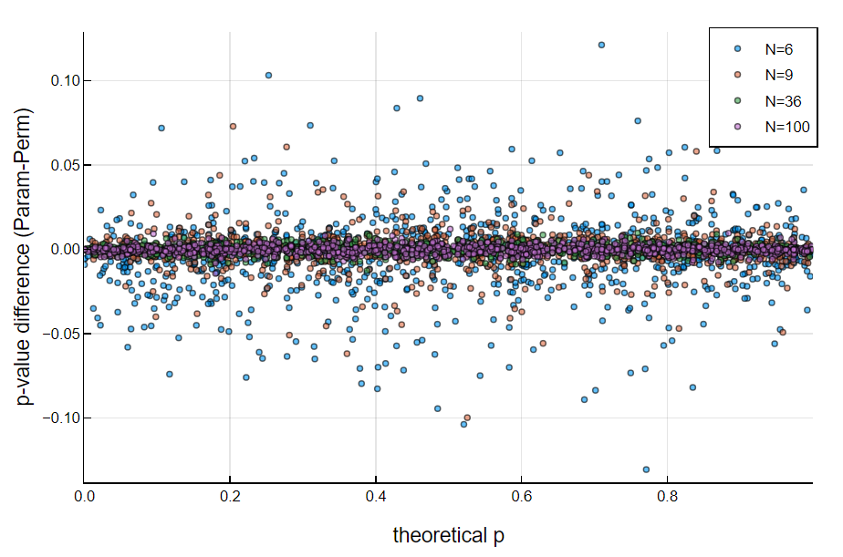
Difference of the p-values obtained by the parametric and permutation test at each simulation
Empirical illustration of asymptotic exacteness of the parametric test
Correlation test
The difference is uniform across theoretical p-values and decreases as N (sample size) increases

Slide 5
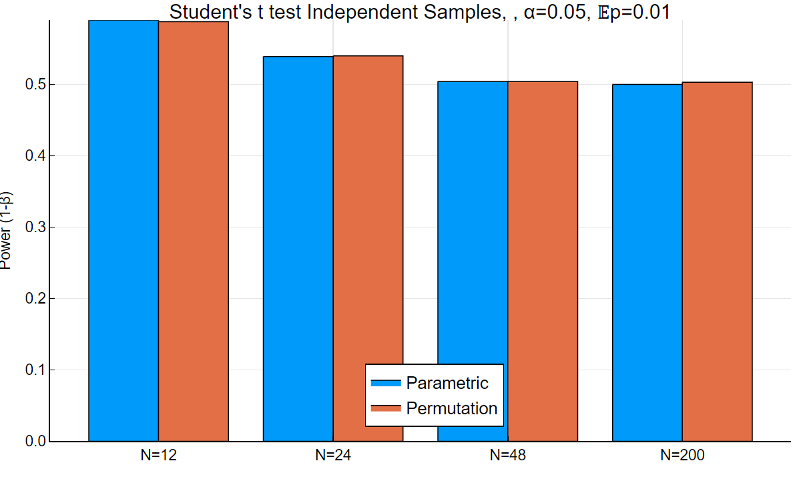
Similar power for permutation and parametric tests. Lower power as compared to the correlation test

Slide 6
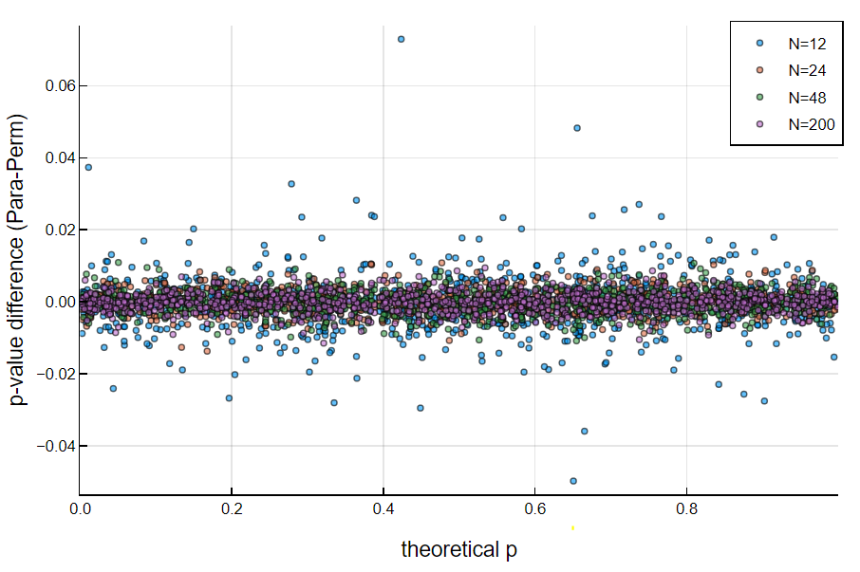
Difference of the p-values obtained by the parametric and permutation test at each simulation
Empirical illustration of asymptotic exacteness of the parametric test
Student’s t test for Ind. Samples
The difference is uniform across theoretical p-values abd decrease as N (sample size) increases

Slide 7
Multiple Comparisons Tests
100 simulations with various number of hypotheses (M) for a given number of observations (N)
Correlated hypothesis are generated under H0 and H1.
The FWE is fixed at 0.05
Permutation tests are exact if the number of possible permutations is <1e5,
approximate otherwise.

Slide 8
Correlation test:
We test the correlation between a variable x and M variables Y.
Random (M+1)-multivariate Gaussian data is generated with expected correlation matrix such that:
- the expected correlation among the Y variables = the value yielding a p-value of 0.1 by a parametric test
- the expected correlation between x and all Y variables = the value yielding a p-value of 0.01 by a parametric test with the chosen sample size, i.e.,
all hypotheses are generated under H1.

Slide 9
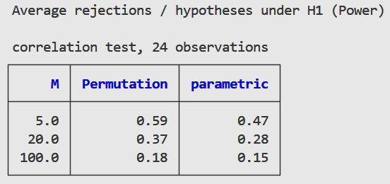
Correlation tests, 100 simulations
5
20
100
On the average of all simulations the permutation max-r test is always more powerful
than the Bonferroni correction procedure. The difference tends to decrease as the number of hypotheses (M) increases

Slide 10
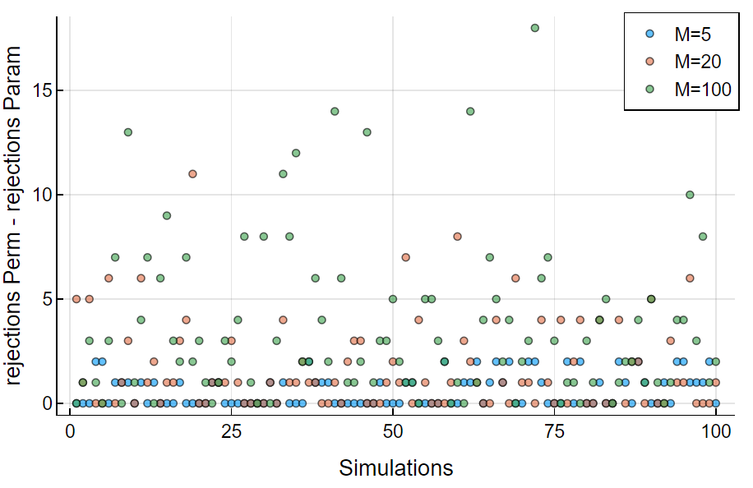
Correlation tests, 100 simulations
The permutation max-r test is always more powerful or as powerful as the Bonferroni correction procedure
(for each simulation the difference of the rejection is always positive)

Slide 11
Student’s t test for independent samples:
We test the difference of means of M pairs of variable variables (x, y).
Let X and Y be the collection of the M x and y variables, respectively.
Random (M)-multivariate Gaussian data is generated independently for both X and Y with expected correlation matrix such that the expected correlation ρ among all M variables = the value yielding a p-value of 1, 0.1 and 0.01 (three sets of simulations) by a parametric test
50% of the hypothesis are generated under H0 and 50% under H1.
For the hypotheses generated under H1, the shift given to mean of the y variable is such that the p-value of a parameric t-test is expected to be 0.01 given the chosen sample size.

Slide 12
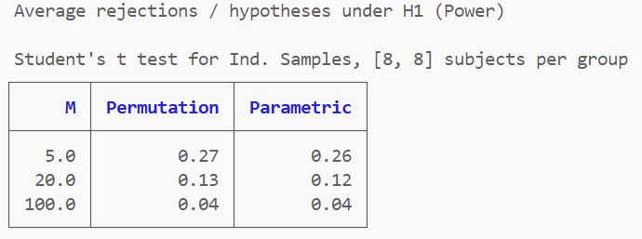
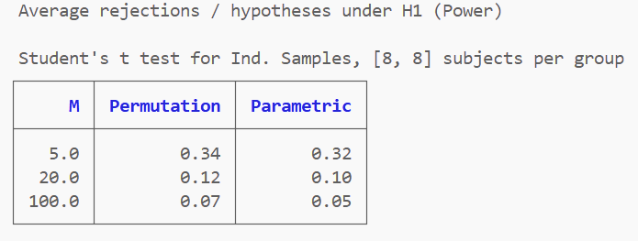
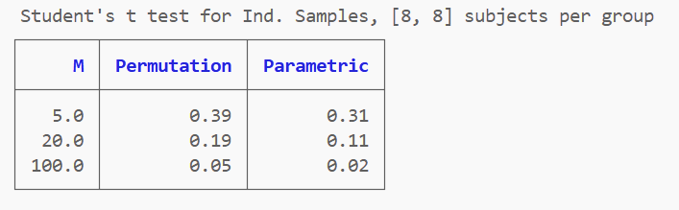
Student’s t tests for independent samples, 100 simulations
5
20
100
𝔼p(ρ) = 1
5
20
100
𝔼p(ρ) = 0.1
5
20
100
𝔼p(ρ) = 0.01
On the average of all simulations the permutation max-t test is always more powerful
than the Bonferroni correction procedure.
The advantage of the permutation approach increases as the correlation among variables (ρ) increases.

Slide 13
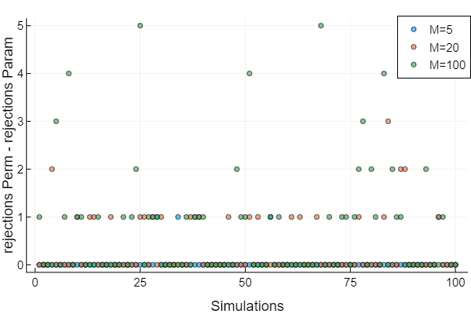
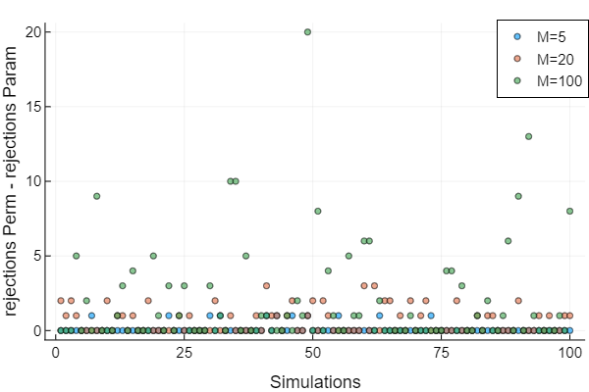
Student’s t tests for independent samples, 100 simulations
𝔼p(ρ) = 0.1
𝔼p(ρ) = 0.01
The permutation max-t test is always more powerful or as powerful as the Bonferroni correction procedure
(for each simulation the difference of the rejection is always positive).
The advantage of the permutation approach increases as the correlation among variables (ρ) increases.

